Slide 1


Company profile
When Science Tends to Infinity

Slide 2

SUMMIT
TECHNOLOGY
ENGINEERING
SUMMIT has been established by a group of engineers with variant international background experiences in Engineering and Construction services with years of combined experience.
CONSTRUCTION
SOLUTIONS

Slide 3


S
Our goals
to provide both a superior customer experience and tremendous value for our customers; we are passionate about exceeding your expectations.
Our values
represent the culture of our staff and our dedication to the customer have made the word SUMMIT more than a company name – it has become symbol for a specific way of doing things: with quality, excellence, innovation, and teamwork.

Slide 4
S
SUMMIT Engineering is looking forward to provide our customers with innovative engineering solution through our accumulated experience to support their business.
Our discipline-based cadre of engineering services covers product design from conceptual studies to aftermarket support. Our talented workforce possesses the breadth and depth of technical expertise that sets us apart from our competition. Technical excellence provided on schedule and within budget yields the best overall value. Additionally, we are proud to provide low cost engineering through our Offshore Outsourcing Engineering Services.

Slide 5
S
SUMMIT Contracting is a core value in our business. With precise strategic planning, we navigate through fast-track schedules, rigorous construction standards, and innovative design-build plans. We help ensure constructability, maintainability, and sustainability and we do it all with an optimal blend of technical expertise, and customer focus.
Our main target to make an adding value to all our customers to reach to Win Win situation

Slide 6
S
Our quality system focuses on sound project management and internal reviews by world-class experts through our USA and Canada based shareholders.
In short, SUMMIT TECS is well equipped to serve your most challenging engineering business needs.

Slide 7
Our projects categories
Projects Categories
Commercial Buildings
Industrial applications
Restaurants
Admin buildings
Residential buildings
Hospitals

Slide 8
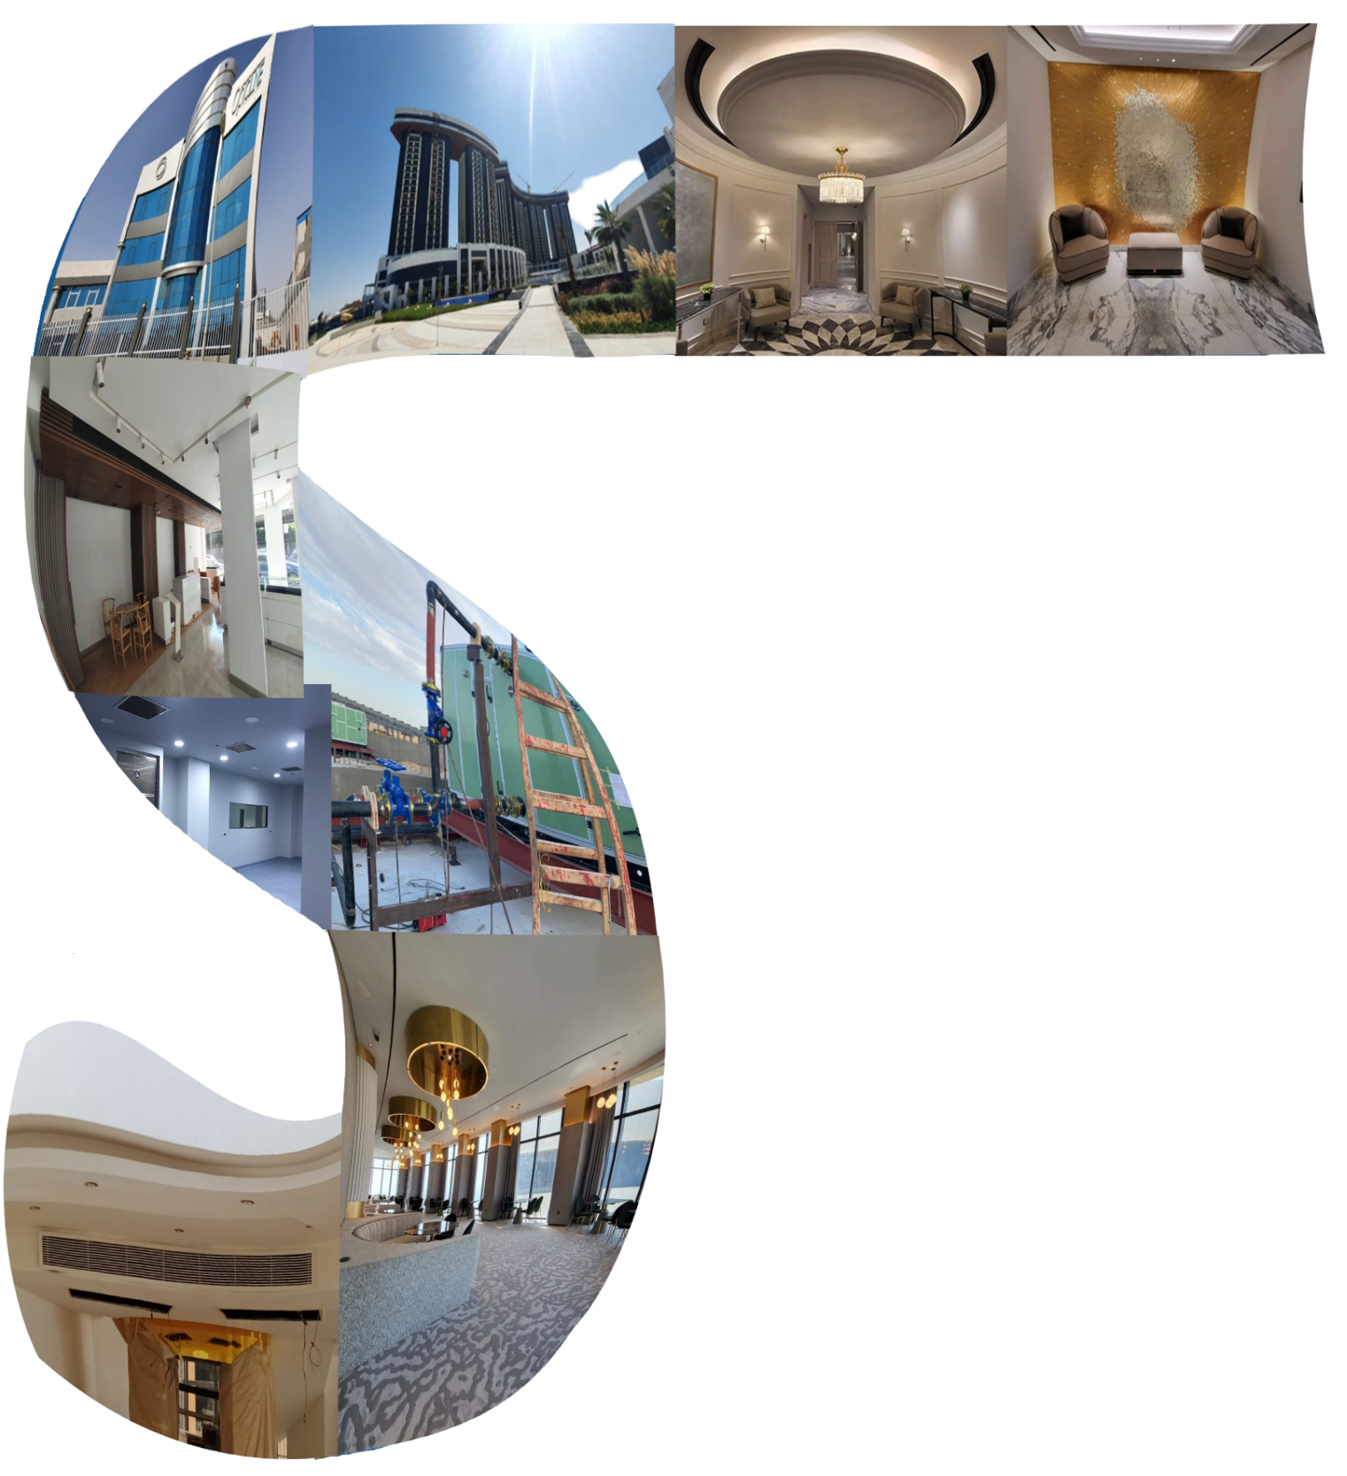
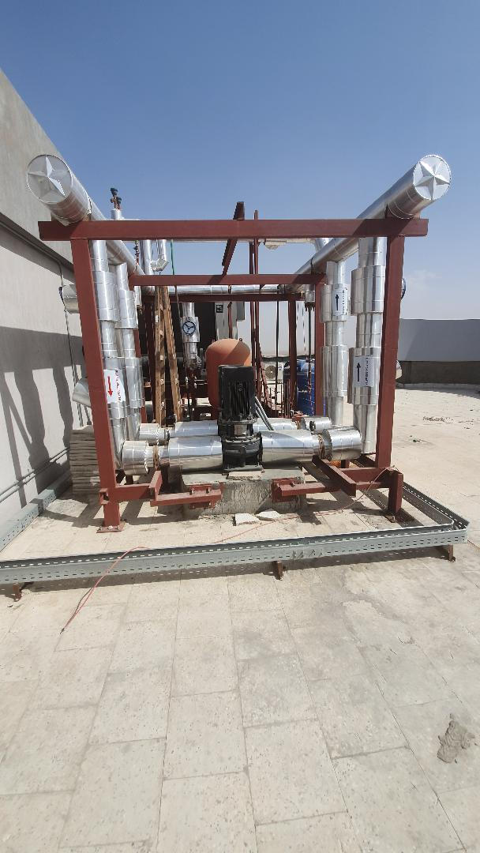
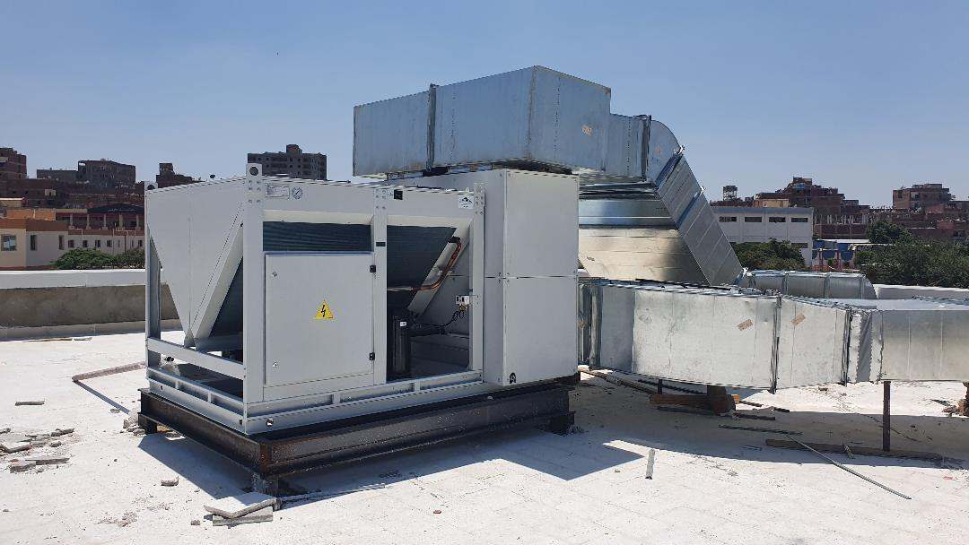
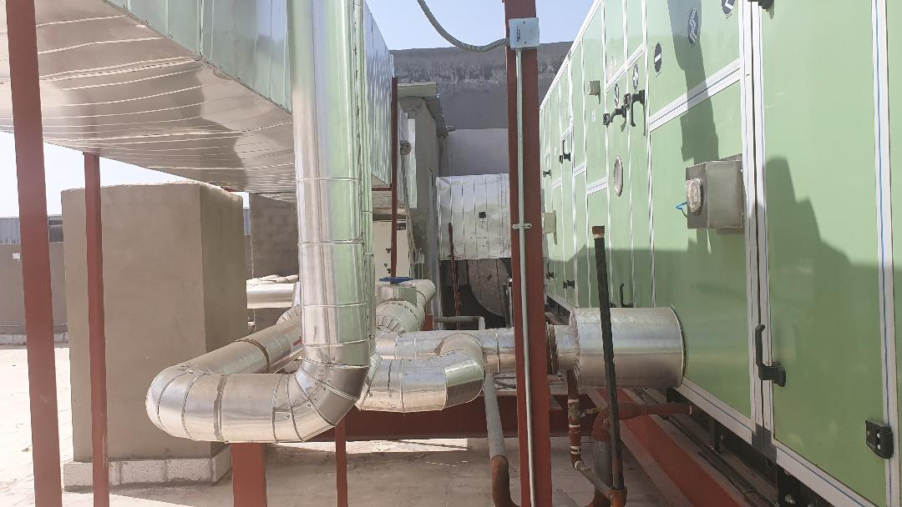
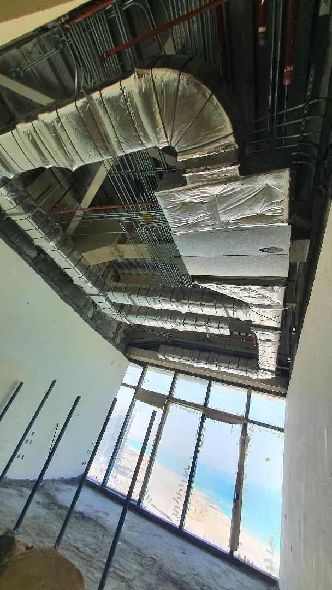
Our Key Partners

Slide 9
























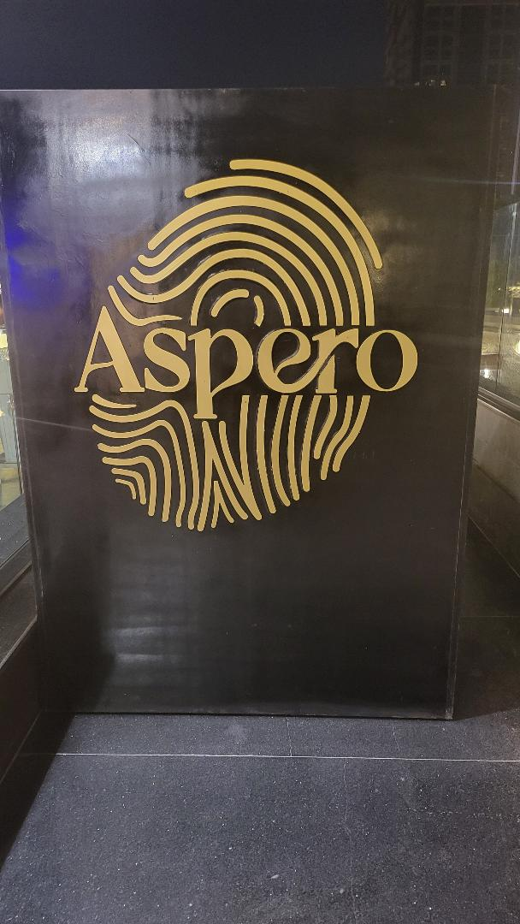




Our Key Partners

Slide 10
Our projects

Slide 11
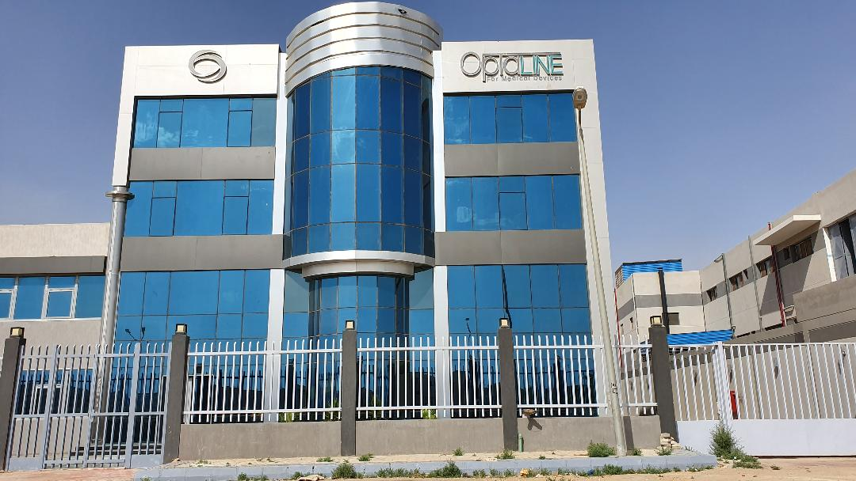
Optaline pharmaceutical Factory
Our scope included supply
and install Electrical work + HVAC
+Firefighting systems
+Fire Alarm systems
for (production area with C class,
stores and admin building)
phase one with total amount
13,500,000 EGP

Slide 12
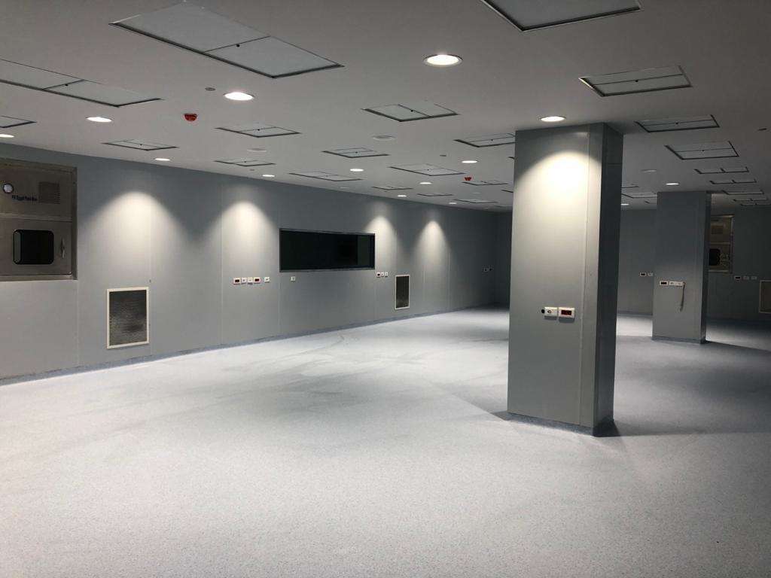
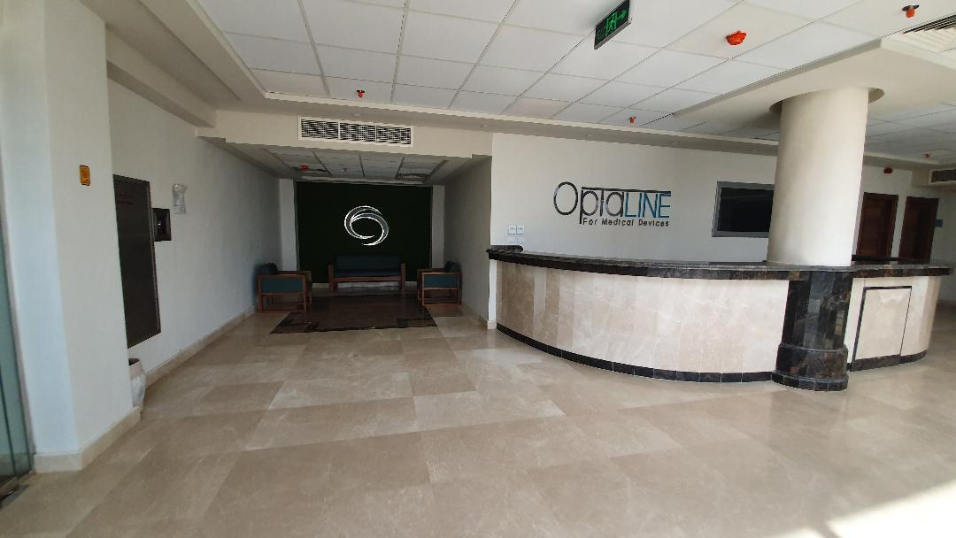
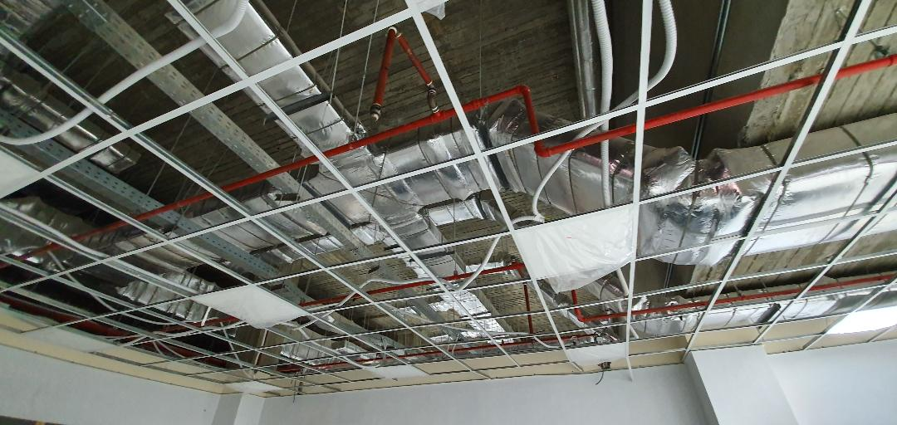
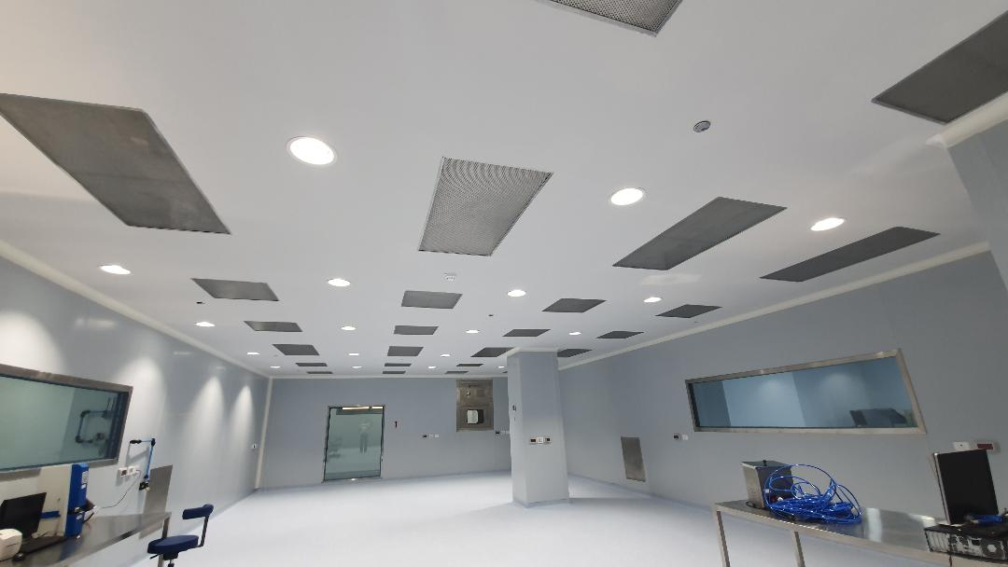
OPTALINE Pharmaceutical Factory

Slide 13
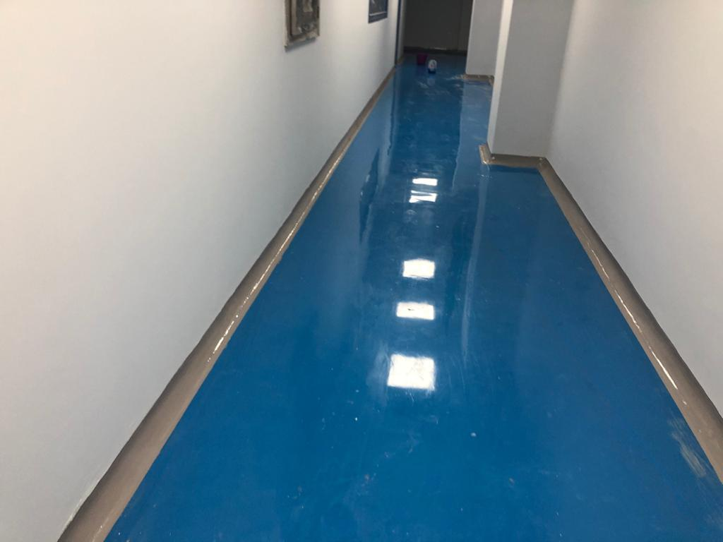
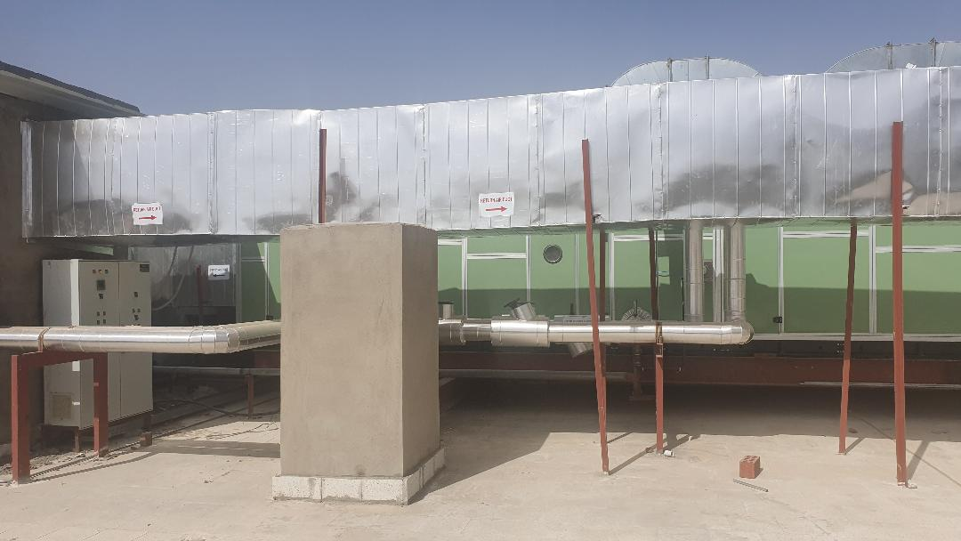
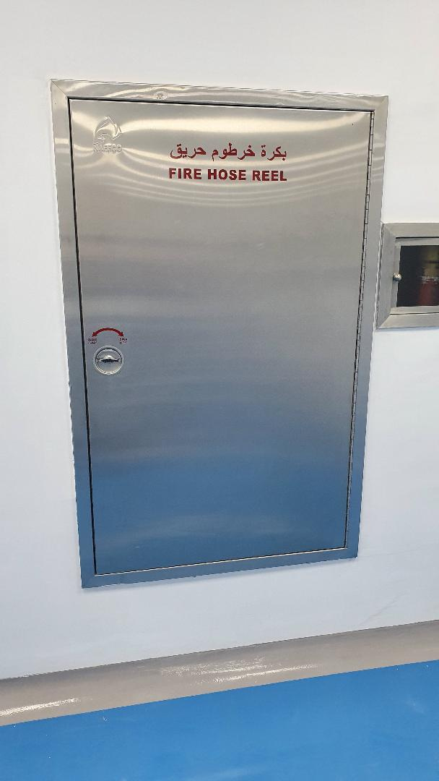
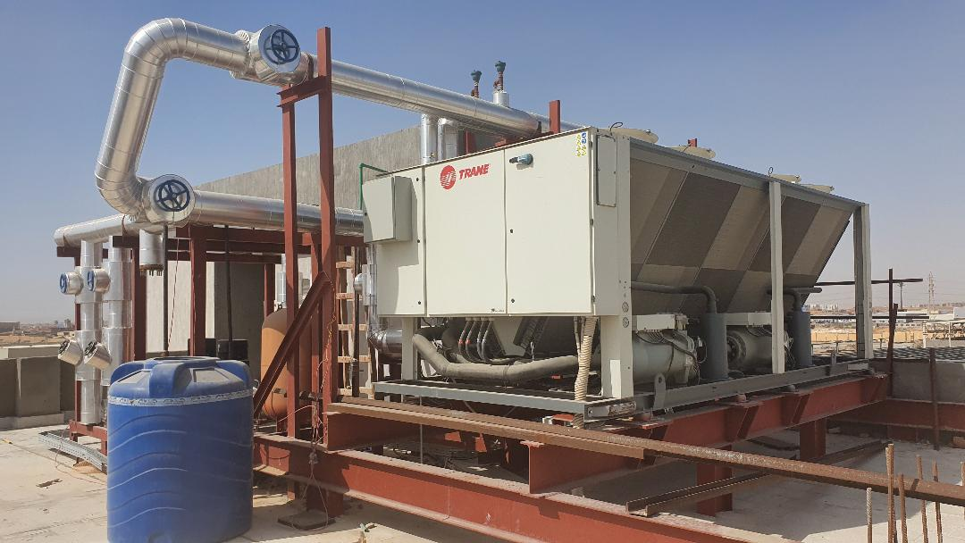
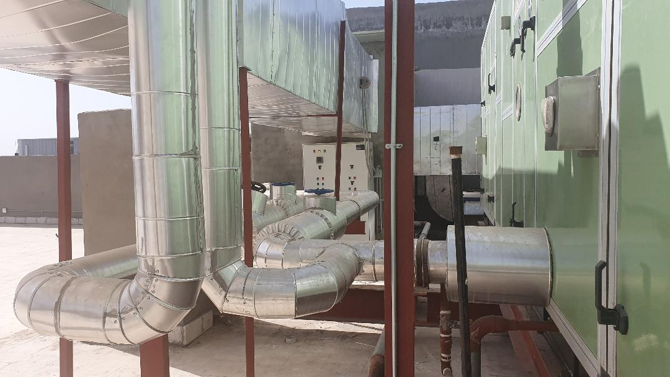
OPTALINE pharmaceutical Factory

Slide 14
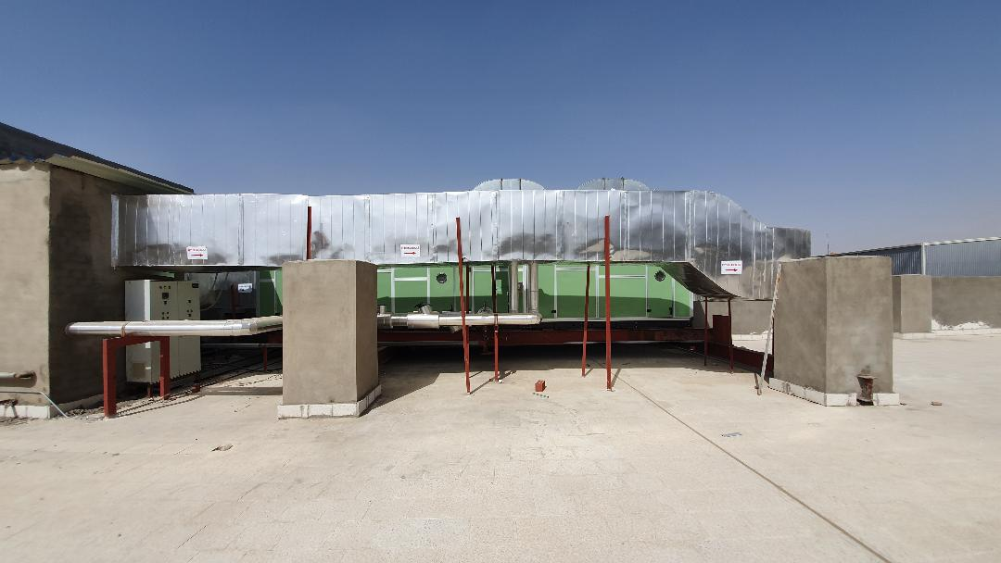
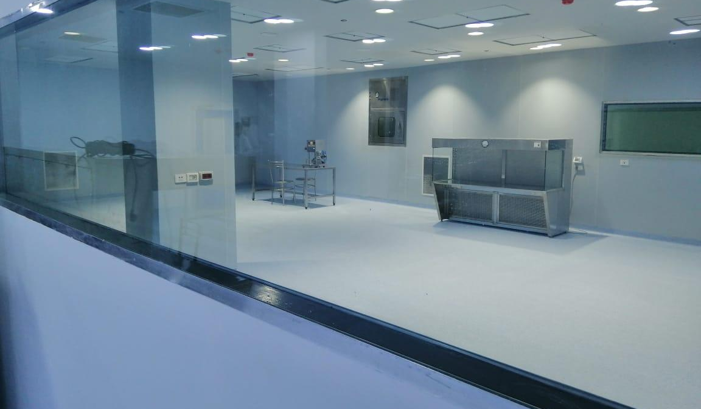
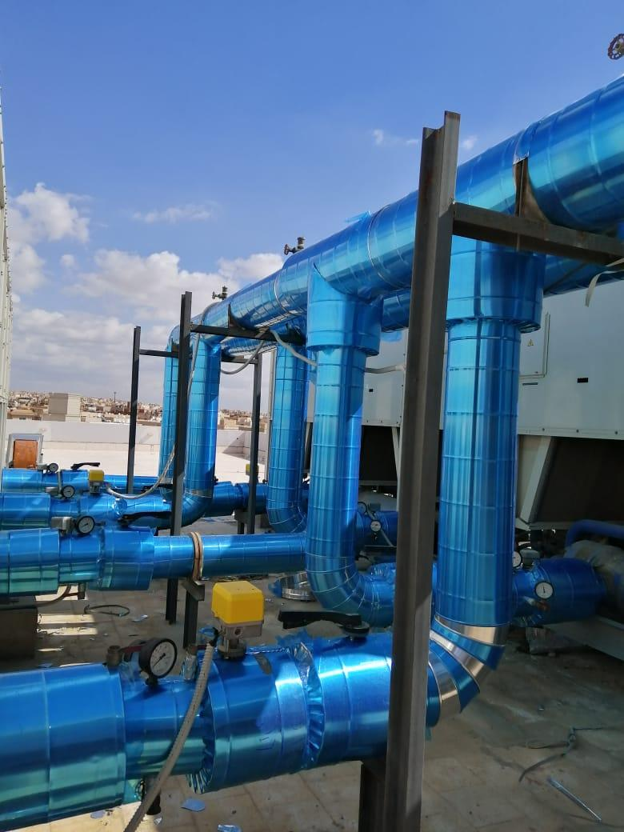
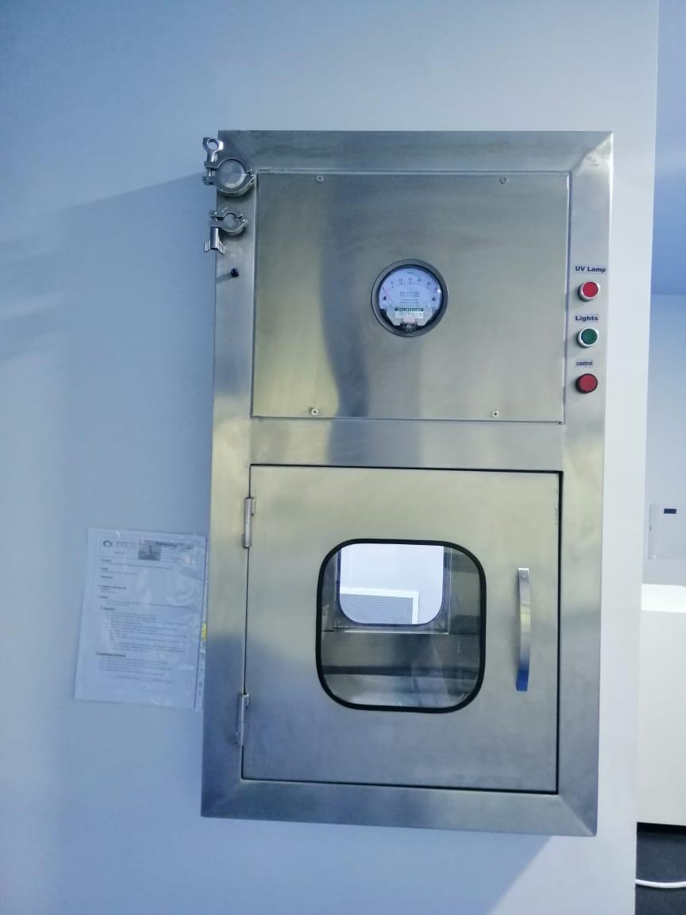
OPTALINE Pharmaceutical Factory

Slide 15
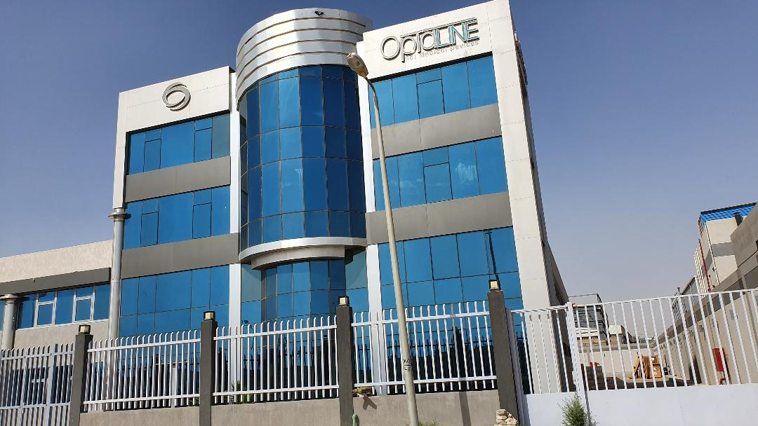
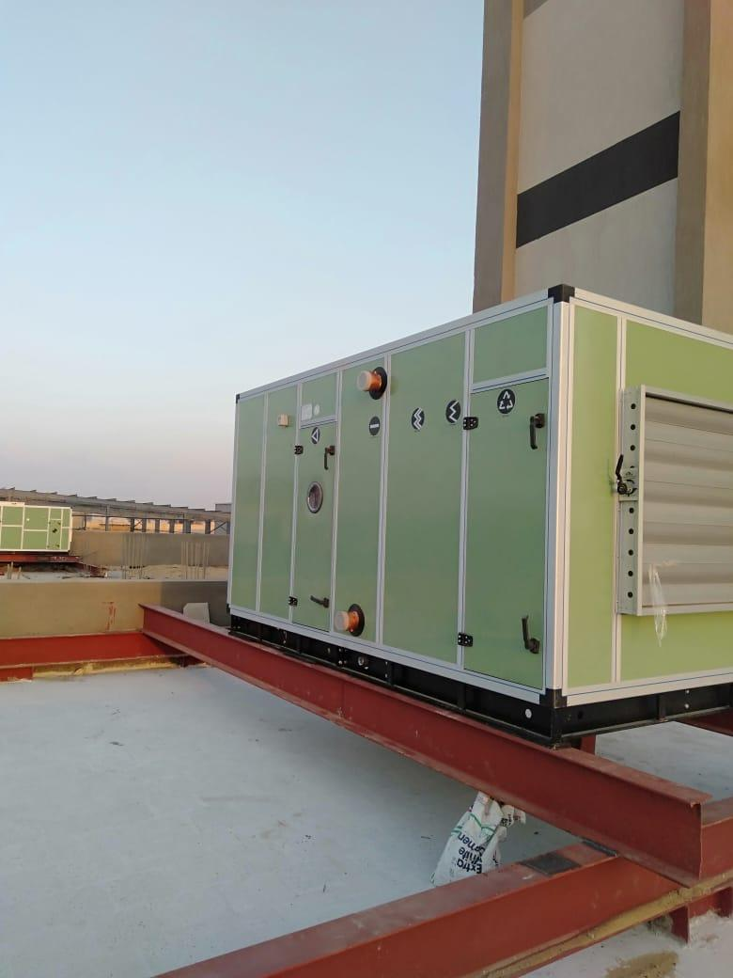
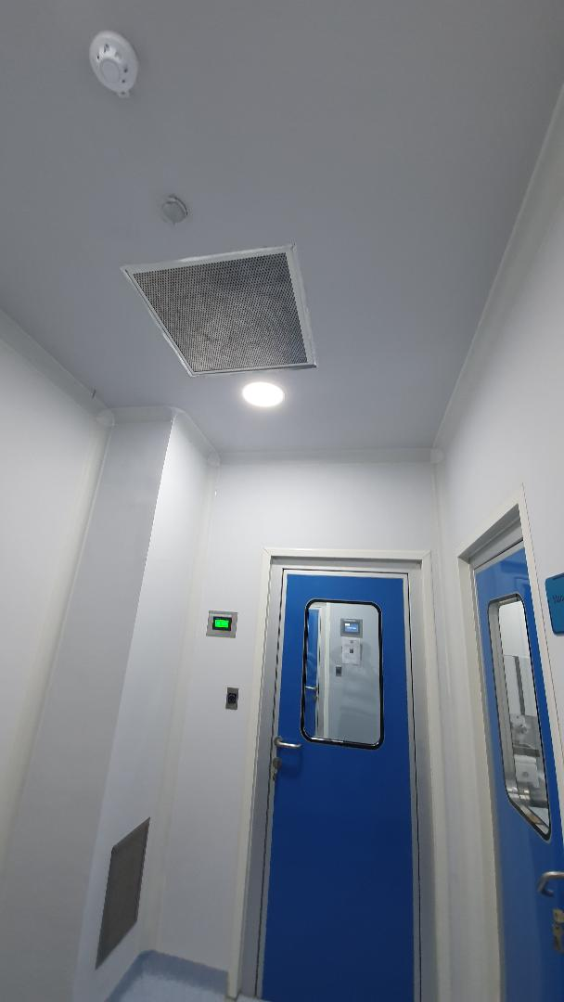
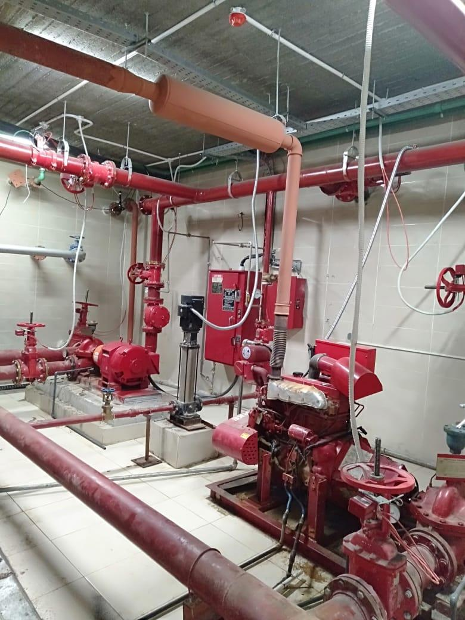
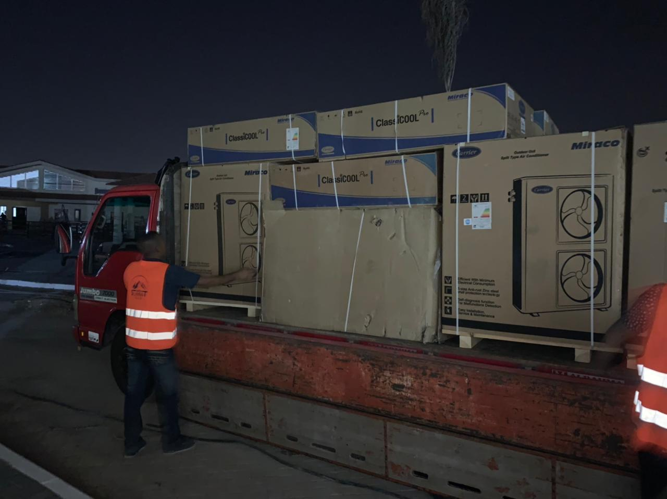
OPTALINE pharmaceutical Factory

Slide 16
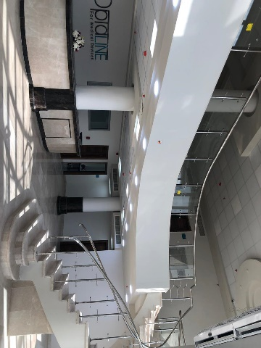
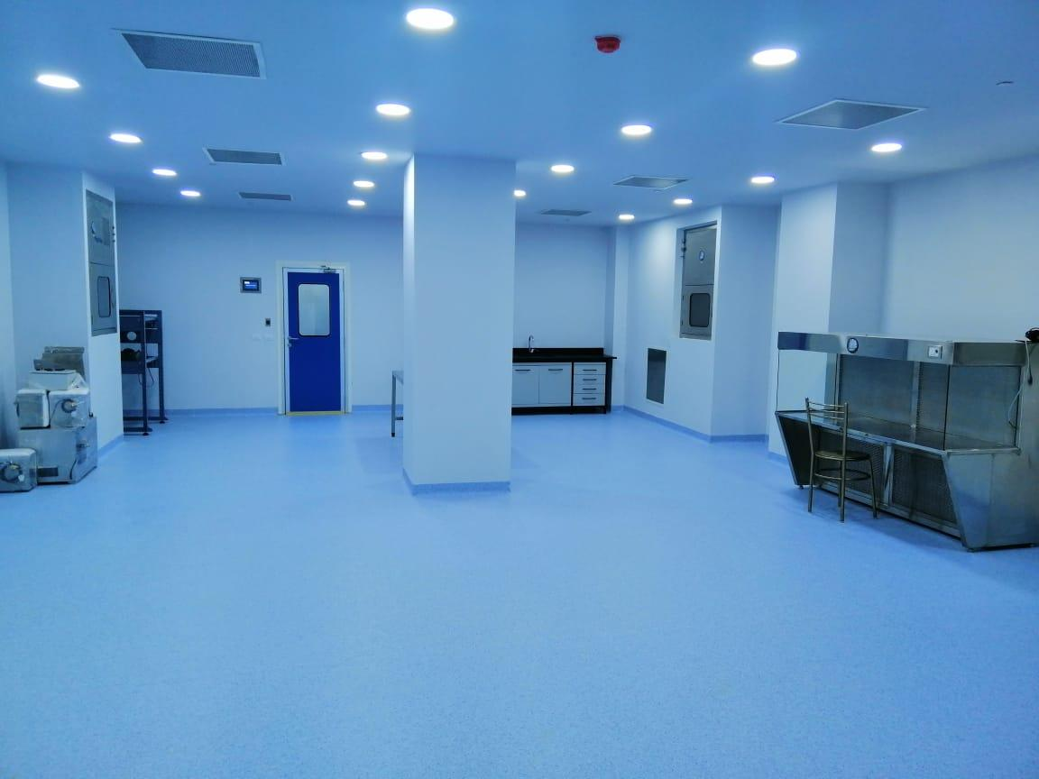
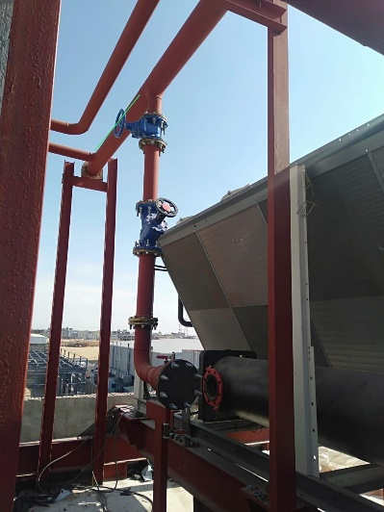
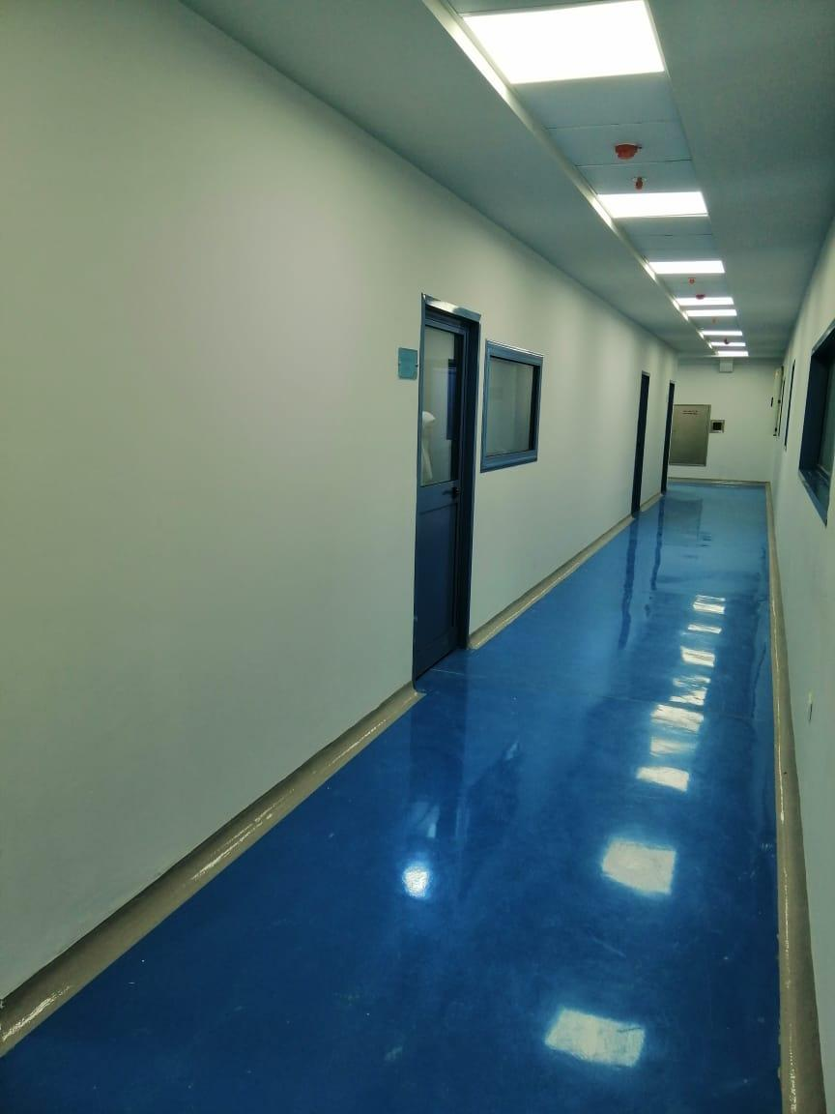
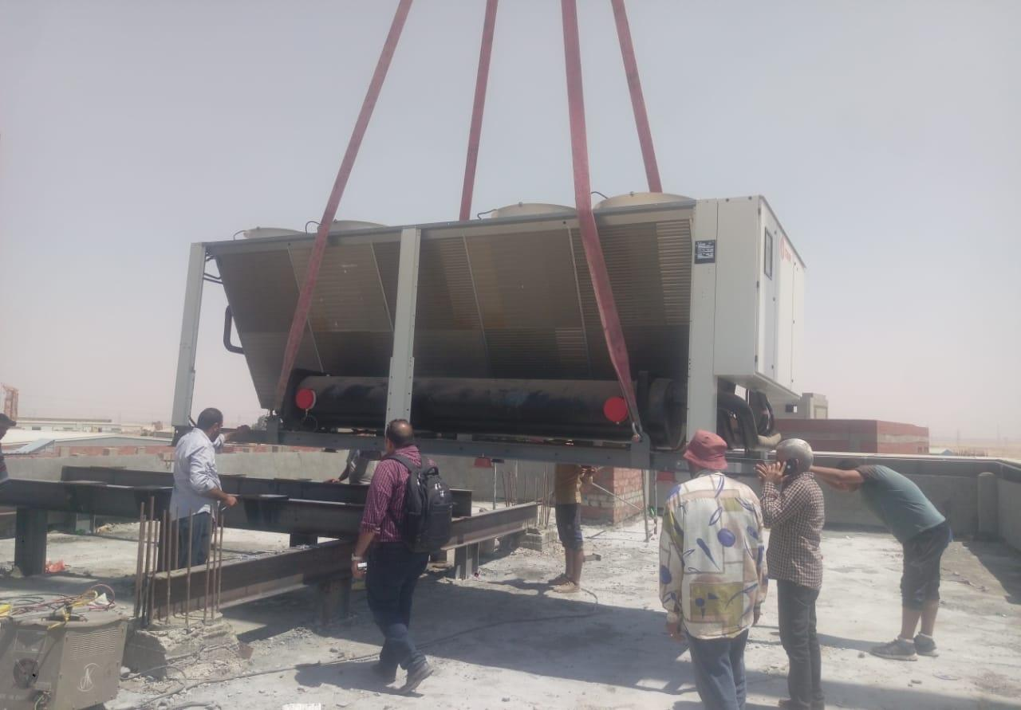

`
OPTALINE Factory

Slide 17
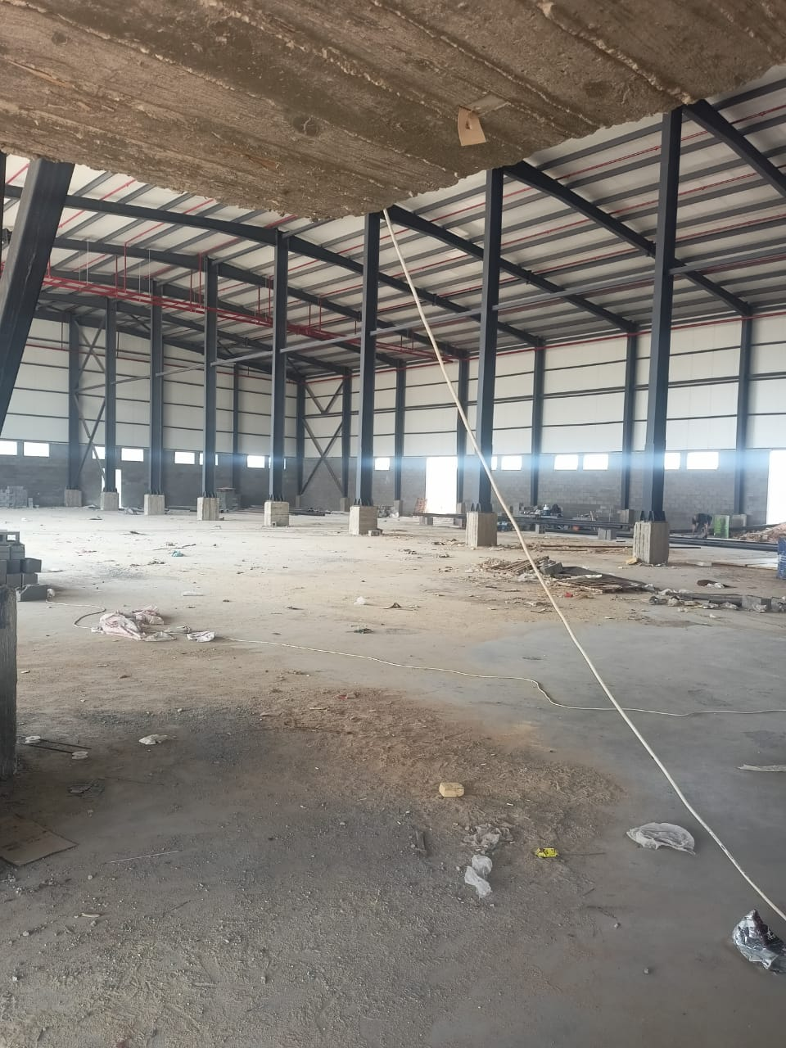
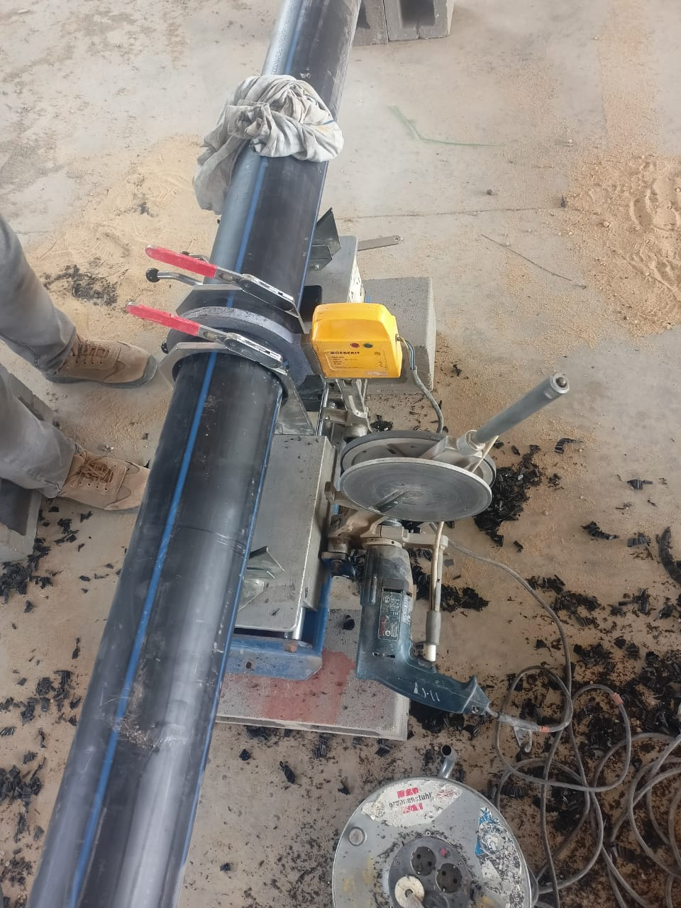
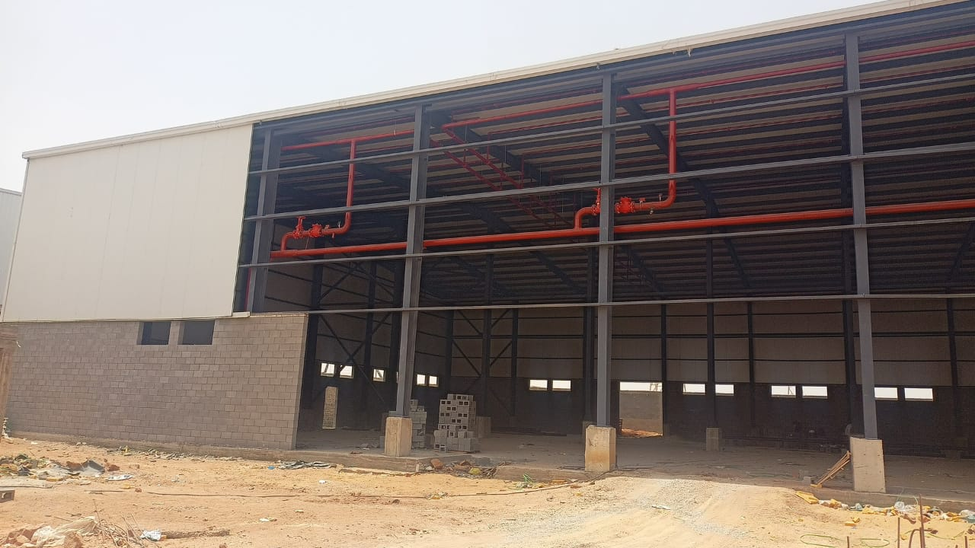
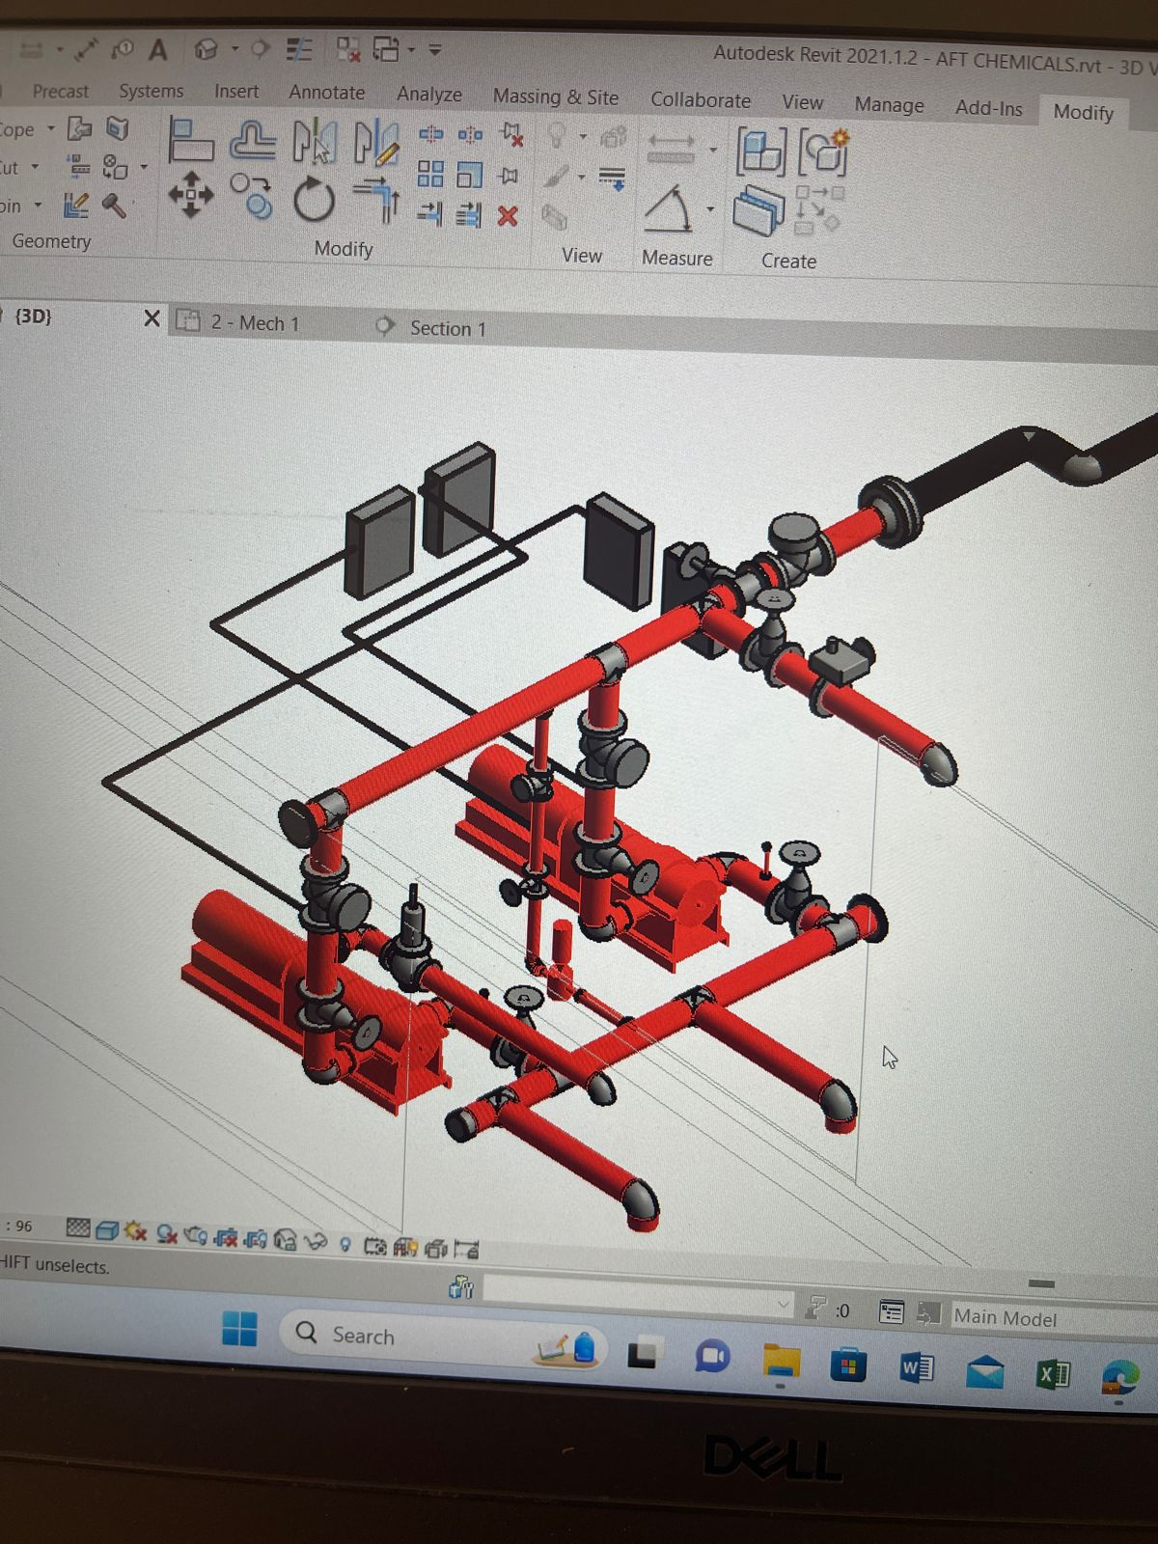
Turn keys Projects
Design & Built
Electrical work
HVAC
Fire Fighting
Light current
Plumping
AFT CHEMICALS Factory & Store

Slide 18
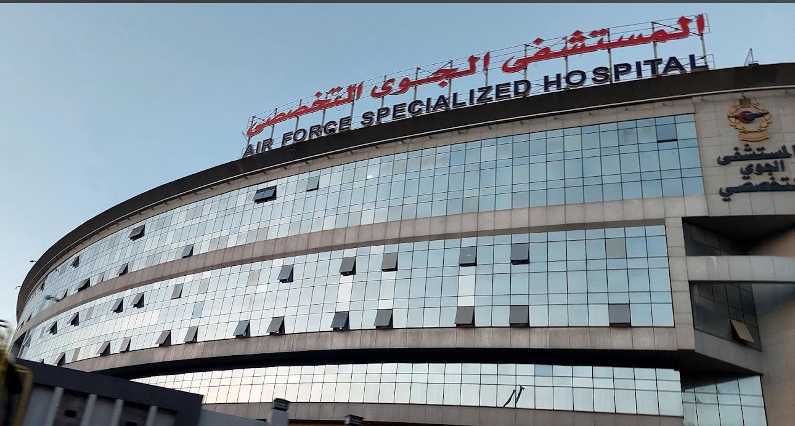
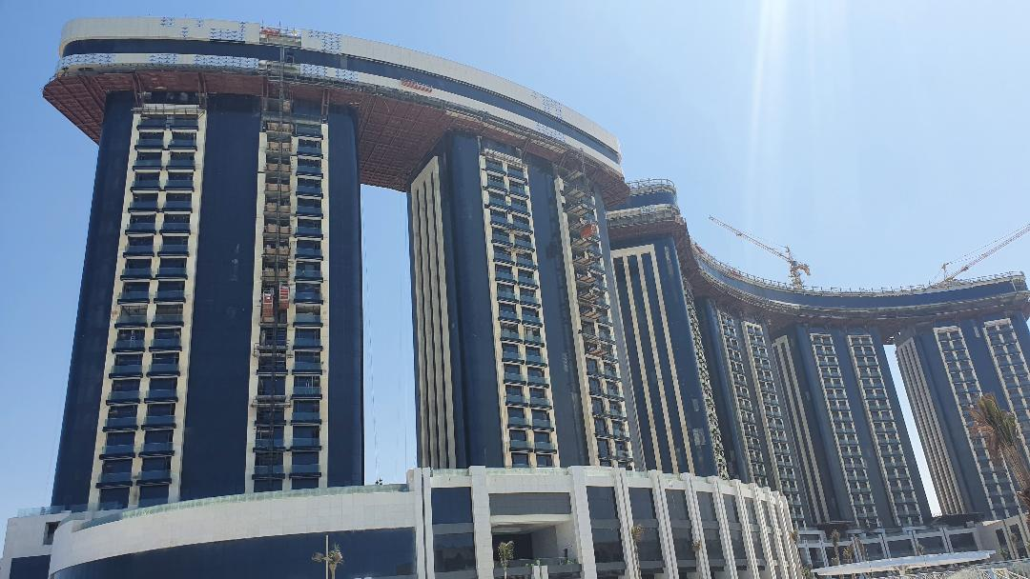
Airforce Specialized Hospital
Supply and install
all Pumps room
To service
hole hospital

Slide 19
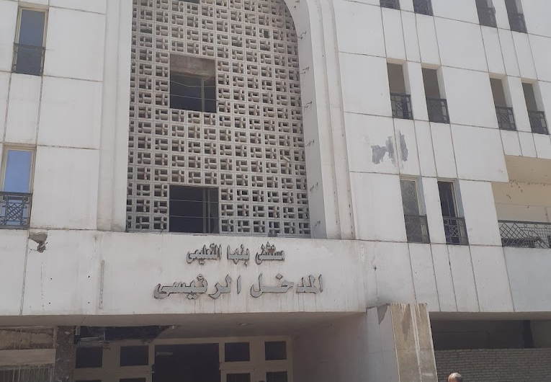
BANHA Hospital
Our scope Renovation and
supply and install Electrical work
+ HVAC for (operation ,clinics,
stores and admin building)

Slide 20
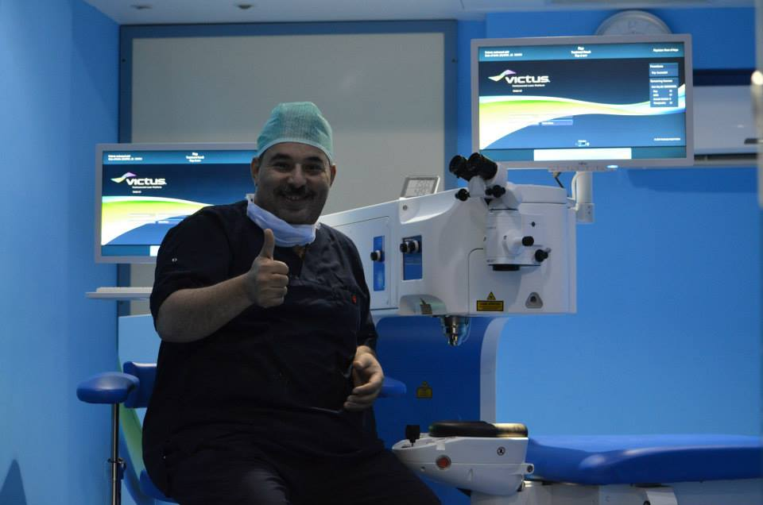
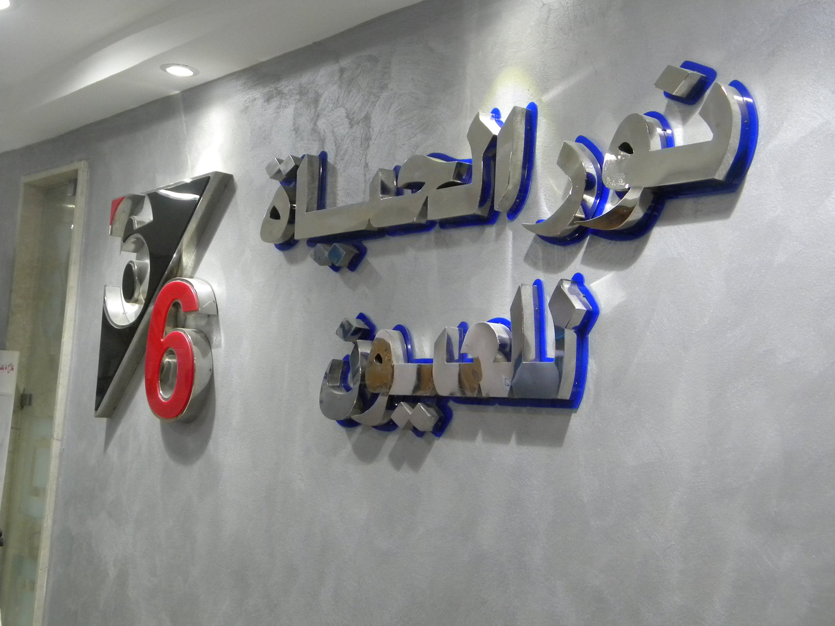
NOOR ELHAYA Hospital
Our scope MEP Packages
supply and install Electrical work
+ HVAC + Fire Fighting

Slide 21
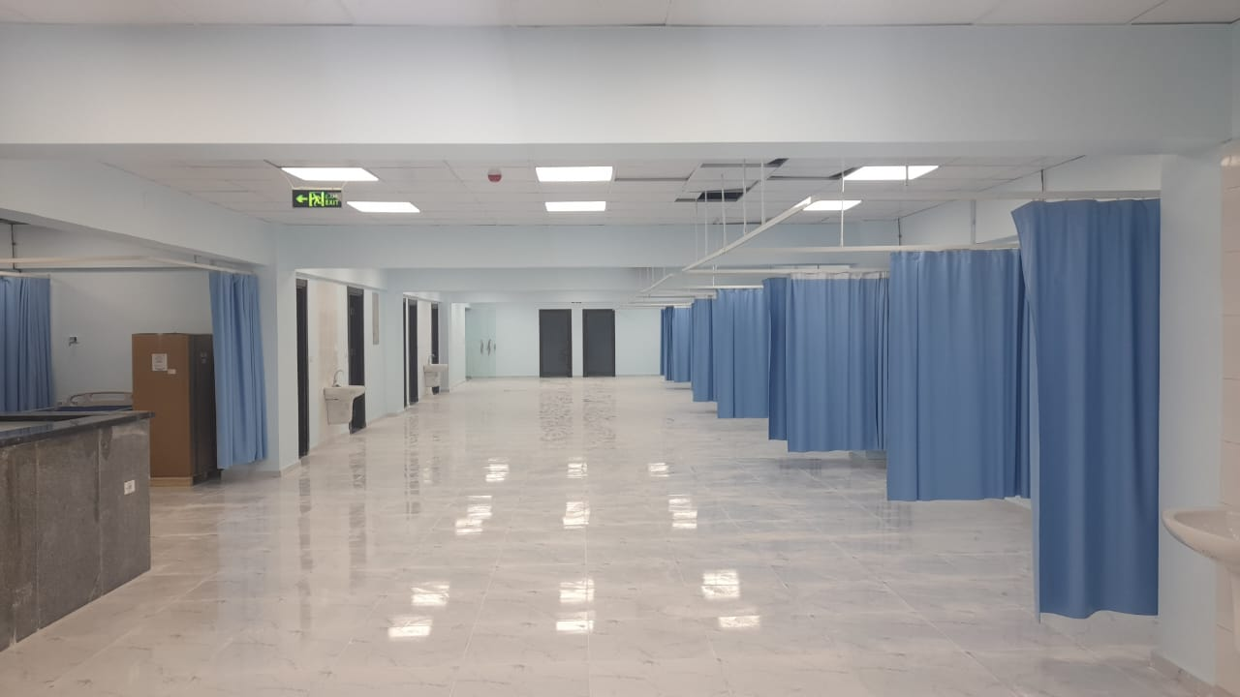
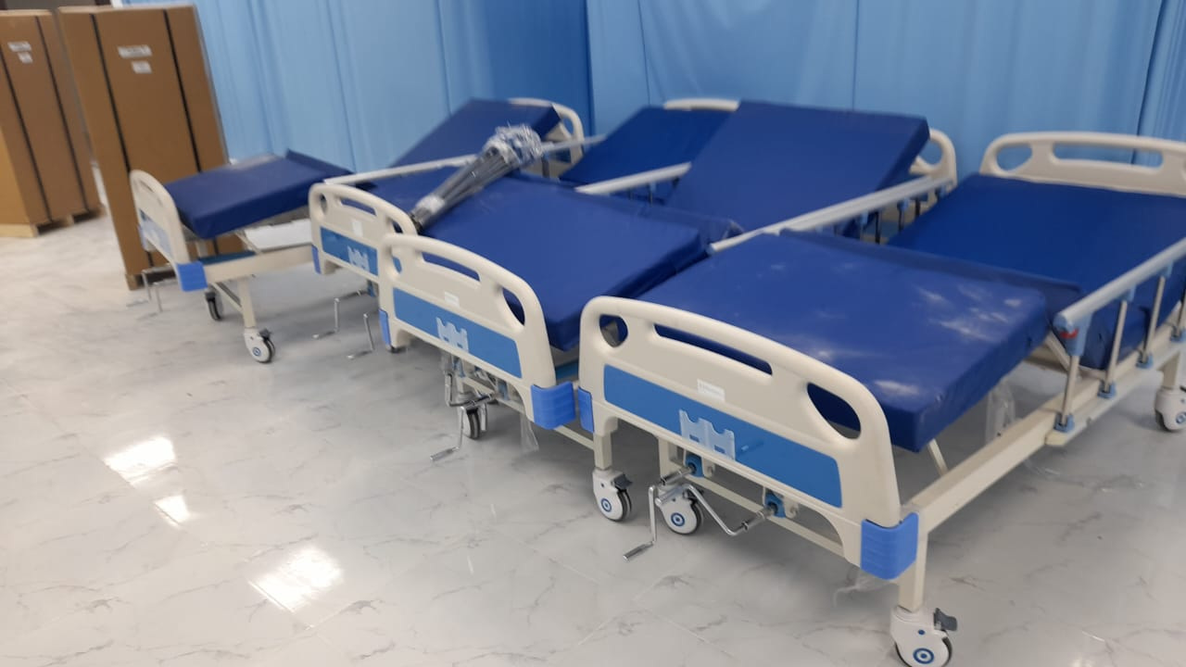
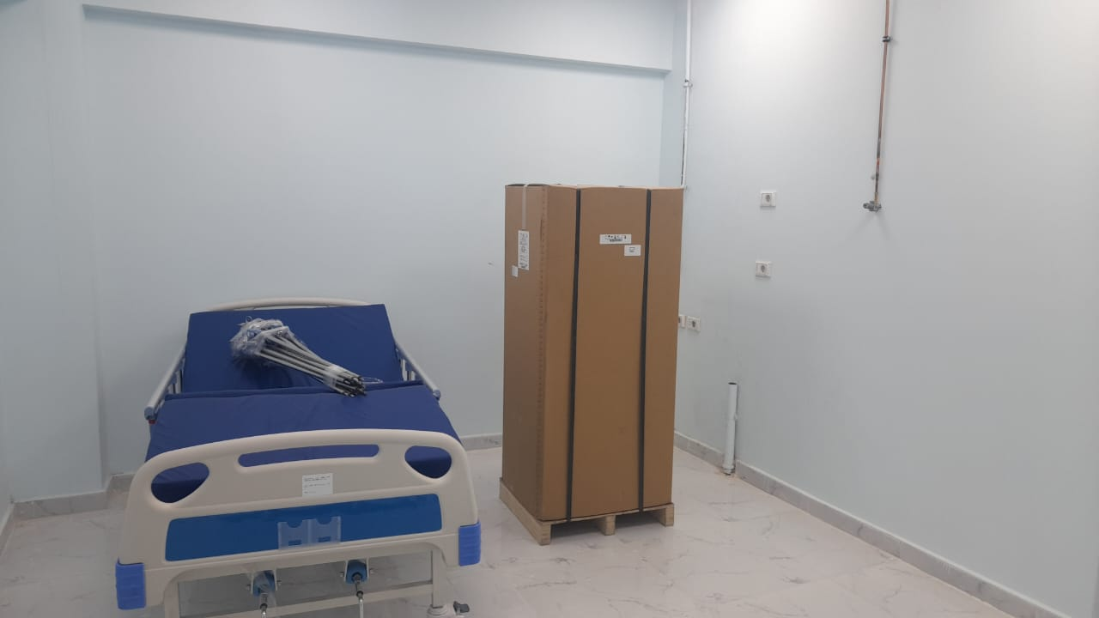
Kafr El-Gebel Specialized Clinics and Dialysis Unit
Our scope MEP Packages
supply and install Electrical work
+ HVAC + Light current

Slide 22
El Alamien project ORASCOM Towers CAP
Supply and install
all mechanical work
for the top floor with
total area 3000 m2
with total value
10,000,000 EGP

Slide 23
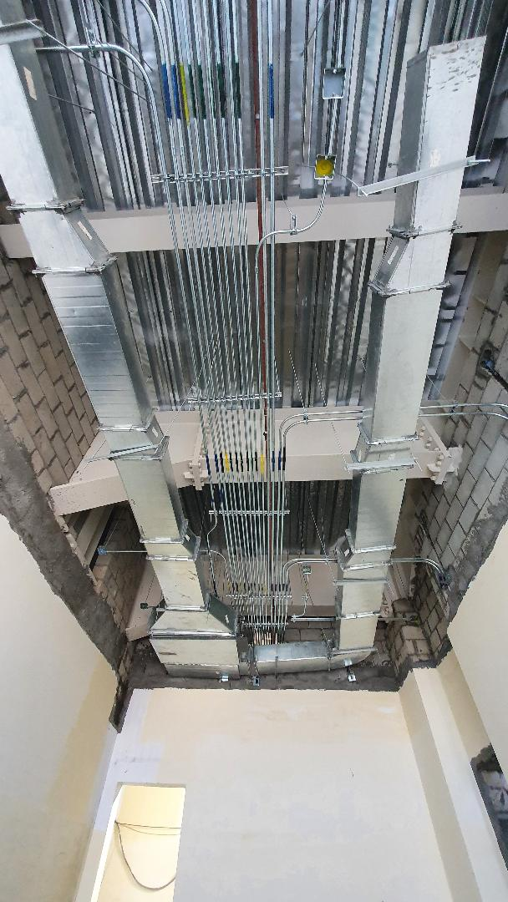
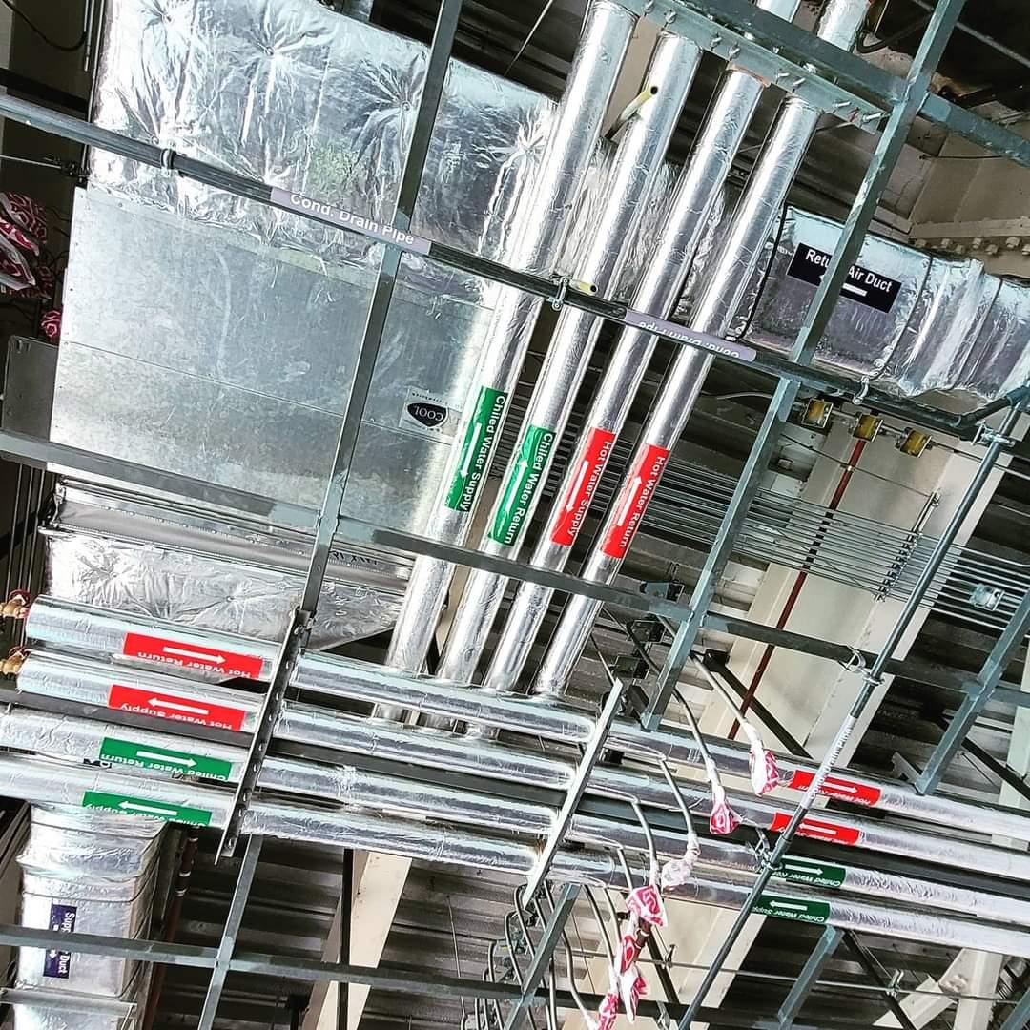
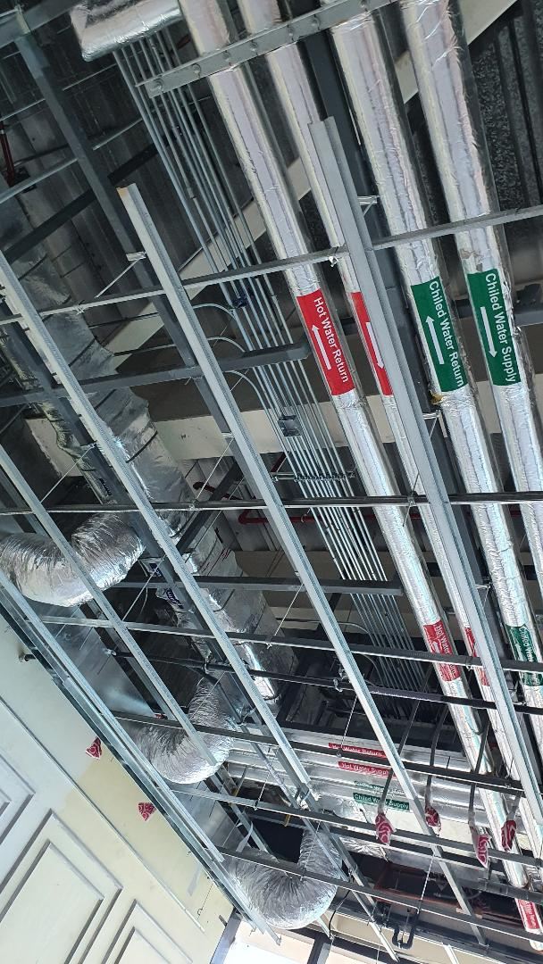
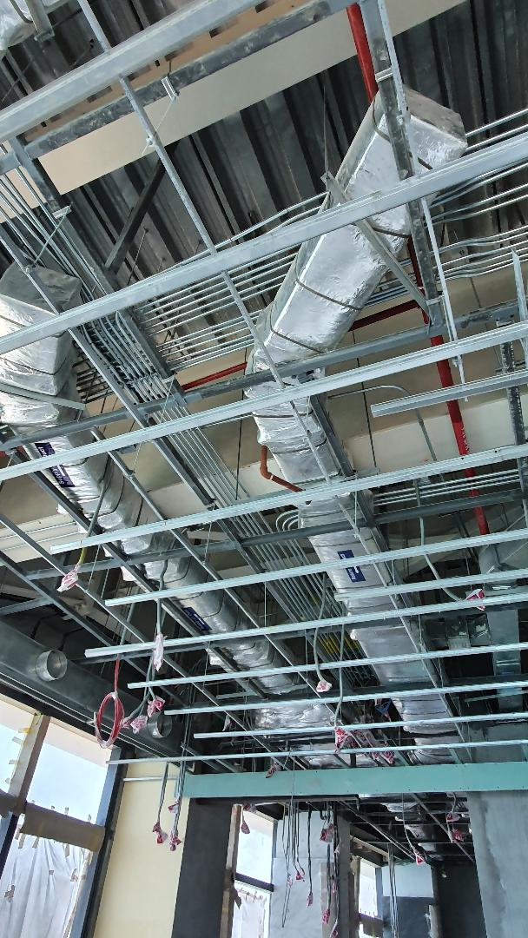
Al Alamien Tower Cap project

Slide 24
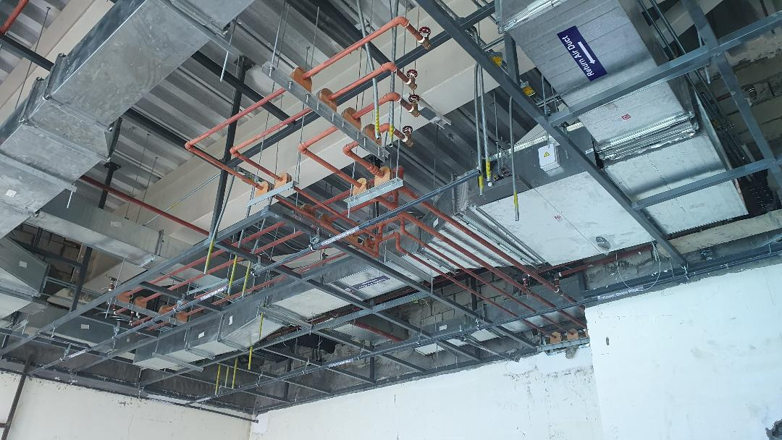
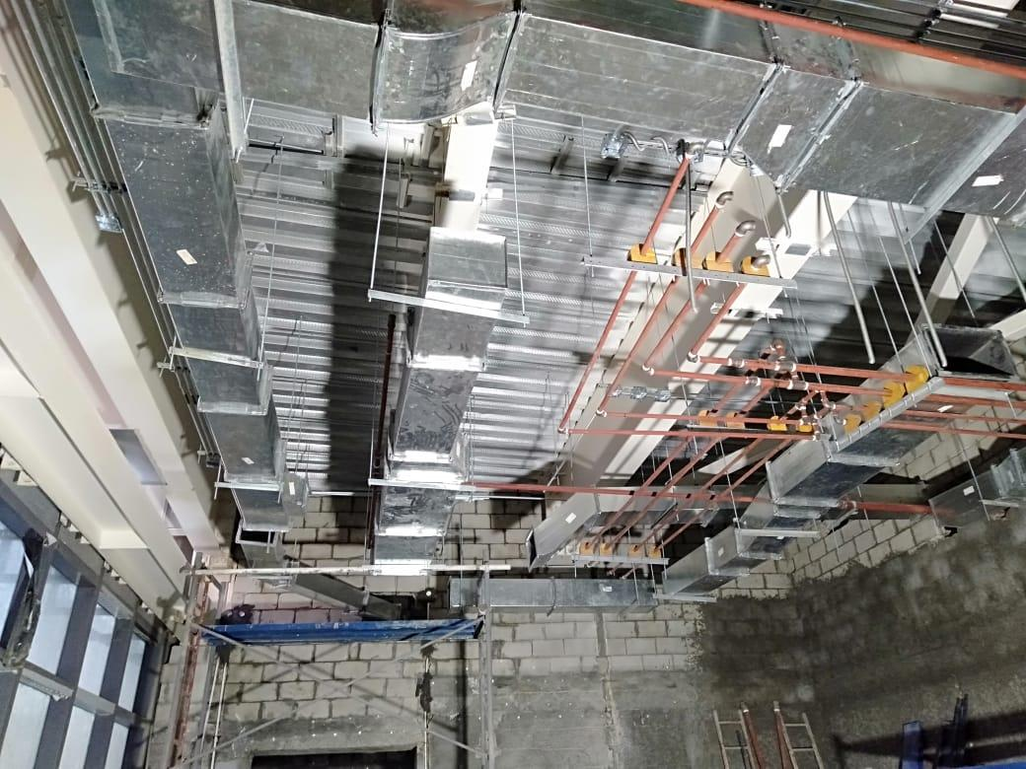
Al Alamien Tower Cap project

Slide 25
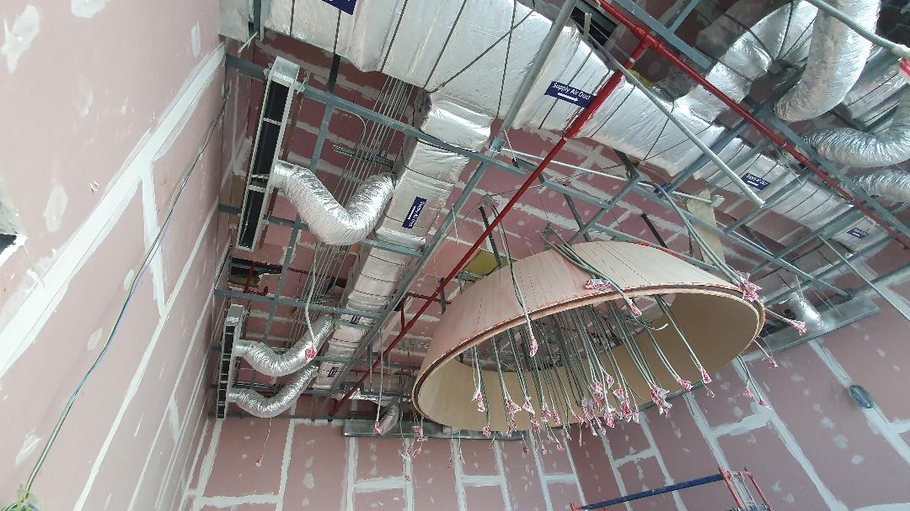
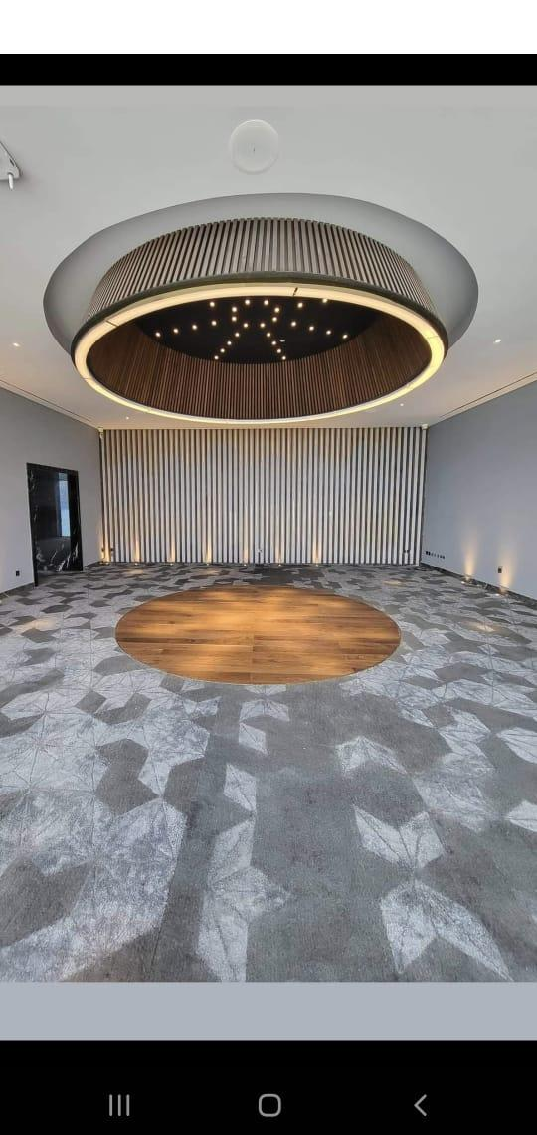
Al Alamien Tower Cap project

Slide 26


Al Alamien Tower Cap project

Slide 27


Al Alamien Tower Cap project

Slide 28


Al Alamien Tower Cap project

Slide 29


WOK & WALK Restaurant
Supply and install
all MEP works for most
Of their branches
“ FC, point 90, Heliopolis”

Slide 30



BITTER SWEET Restaurant
Supply and install
all MEP works for most
Of their branches

Slide 31


VARIEGATO Restaurant
Supply and install
all MEP works for most
Of their branches

Slide 32



VOLVO Show Room Mohndsein
Supply and install
all MEP works

Slide 33

Police Horse Riding club
Supply and install
all HVAC & F.F works
With total value
5,000,000 EGP

Slide 34






Police Horse Club project

Slide 35





Police Horse Club project

Slide 36

ASPERO restaurant platform
Supply and install
all MEP works
With total value
8,000,000 EGP

Slide 37





15 May Court
Supply and install
all MEP works
With total value
12,000,000 EGP

Slide 38






Life Eyes Resort
Police Nasr Club

Slide 39






Slide 40







Slide 41


DEL SOL Cafe
Supply and install
all MEP works

Slide 42



DEL SOL Cafe
Supply and install
all MEP works

Slide 43

Smart international school in october
Supply and install
all HVAC works for
all school

Slide 44




Smart International school

Slide 45


ELLIE HOME
Supply and install
all MEP works
(All Branches )

Slide 46



ELLIE HOME
Supply and install
all MEP works
(All Branches )

Slide 47






`
SUMMIT several projects

Slide 48





`
SUMMIT several projects

Slide 49





`
SUMMIT several projects

Slide 50





`
SUMMIT several projects

Slide 51





`
SUMMIT VRF projects

Slide 52
`
SUMMIT prequalification's
1. | Supply /Install | Aswan stadiums Subcontractor - National Defense Company | Electrical work (1main stadium +6 Sub stadiums )
2. | Construction | Badr City Subcontractor - Ministry of housing | MEP works + Civil work (5 buildings)
3. | Construction Supply/Install | Badr City Subcontractor - Ministry of housing | Electrical work + Civil work (15 electrical chambers)
4. | Install | Aswan stadiums Subcontractor - National Defense Company | HVAC work (20 Units- Hall Games)
5. | Construction | El Mania stadium Subcontractor - National Defense Company | Demolishing work (Main stadium+3 Buildings)
6. | Install | Siwa power station Subcontractor – Enviromena CO. – Emirates grant | Solar System (10 MWatt )
7 | Supply/Install | Electrical Laboratory Subcontractor – Military Technical collage | Trade /Electrical works
8 | Supply/Install | Girls House Subcontractor – Cairo university | Electrical work (one Building )

Slide 53
`
SUMMIT prequalification's
9 | Supply/Install | Sadat City –El Andals Farm Main Contractor | Fuel tank system (2Tanks) + Electrical / Mechanical works
10 | Supply/Install | Siwa power station Subcontractor – Enviromena CO. – Emirates grant | Firefighting Systems
11 | Supply/Install /Maintenance | Air Defense House Subcontractor – Petroserve CO. | Electrical work (Supply 4 sub stadiums + Maintenance main stadium )
12 | Supply/Install | El Salam industry Co. (MAC ) Main Contractor | Electrical work + HVAC +Firefighting systems (Office building)
13 | Install | Tanks House Subcontractor – Petroserve CO. | Electrical work
14 | Design Supply/Install | Wok and Walk –Point 90 Mall Main Contractor | Electrical work + HVAC +Firefighting systems +Fire Alarm systems
15 | Construction | El Mania stadium Subcontractor - National Defense Company | Civil work+ Electrical works (Main stadium)
16 | Construction | National Defense/ office buildings Subcontractor – Contrade Co, | Demolishing work (Antenna towers+7 Buildings+)

Slide 54
`
SUMMIT prequalification's
17 | Supply/Install | Masters School -6th October Subcontractor – Triple F Co, | Tanks +Firefighting+ 3Pool
18 | Construction | Suez Governorate Subcontractor – Blue Star Co, | Electrical work + Civil (Suez district garden)
19 | Supply/Install | Ain Shams University- Faculty of medicine Main Contractor | HVAC (Ain shams Studio)
20 | Construction | Suez Governorate Subcontractor – Blue Star Co, | Electrical work + Civil (Garage wall)
21 | Design Supply/Install | Wok and Walk –Cairo Festival City Mall Main Contractor | Electrical work + HVAC +Firefighting systems +Fire Alarm systems
22 | Construction | Suez Governorate Subcontractor – Blue Star Co, | Electrical work + Civil (Corniche Construction)
23 | Construction | Suez Governorate Subcontractor – Blue Star Co, | Electrical work + Civil (Pavement Construction)
24 | Trading | Yathrib Company -Beverly Hills Main Contractor | Electrical work BEL AIR Mall/Office Buildings

Slide 55
`
SUMMIT prequalification's
25 | Supply/Install | Wok and Walk –El Marghany Branch Main Contractor | HVAC
26 | Design Supply/Install | Mr Mahmoud Fayez Villa Main Contractor | Electrical work + HVAC +Smart System +pool
27 | Supply/Install | Air Force Hospital -5Th Settlement Sub Contractor- IES/Grundfos Agent | MEP work Pump Room
28 | Design Supply/Install | Mr O. Elgarawany Villa -5Th Settlement Main Contractor | Electrical work + HVAC +Smart System
29 | Maintenance | Enppi Company Main Contractor | HVAC
30 | Design Supply/Install | Mr Tarek Villa -Grand Heights Main Contractor | Electrical work + HVAC +Smart System+ pool
31 | Design Supply/Install | Mr.M Salam Villa- Nour Vally Main Contractor | Security Systems
32 | Supply | Sedico Company | Fire Products

Slide 56
`
SUMMIT prequalification's
34 | Design Supply/Install | Mr.A.Samy Villa-October Main Contractor | Electrical work + HVAC + Security Systems
35 | Supply/Install | Dr.Ghada Villa-West Town Main Contractor | HVAC
36 | Design | Plam Hills compound Sub-Contractor- IES/Grundfos Agent | Pump Room
37 | Supply/Install | Dara Villa-October Main Contractor | HVAC
38 | Supply/Install | Duonz Villa-October Main Contractor | Demolishing work+ Electrical work + HVAC
39 | Design Supply/Install | Mr.Ahmed Fayez Villa -West Main Contractor | Electrical work + Plumbing +HVAC +Smart System +pool +Solar Systems
40 | Design | Wok and Walk –City stars Mall Branch Main Contractor | Electrical work + HVAC +Firefighting systems +Fire Alarm systems
41 | Design Supply/Install | Mr.A.Samy Villa-October Main Contractor | Electrical work + HVAC + Security Systems

Slide 57
`
SUMMIT prequalification's
42 | Install | Banha Hospital Subcontractor-Defense Agency | HVAC
43 | Supply/Install | Eng M.Yosif Villa October Main Contractor | Electrical work + HVAC + Security Systems
44 | Design Supply/Install | Mr Mohamed/Elrabwa Villa Main Contractor | Smart System +Electrical work + HVAC +Firefighting systems +Fire Alarm systems
45 | Design Supply/Install | Optaline Factory Main Contractor | Electrical work + HVAC +Firefighting systems +Fire Alarm systems
46 | Supply/Install | Master School- Elementary school Main Contractor | HVAC
47 | Design Supply/Install | Zivago -Capital Business Mall/October- Main Contractor | Electrical work + HVAC+ Security Systems
48 | Design Supply/Install | Mr Girgs Palace -Concord Villa -5Th Settlement Main Contractor | HVAC+ Firefighting systems
49 | Supply/Install | Al Almain Cap – El Masa Ministry of Defense | HVAC +Firefighting systems

Slide 58
`
SUMMIT prequalification's
50 | Design Supply/Install | Equestrian /Riding Horses Club – Police Ministry Main Contractor | HVAC +Firefighting systems+ Fire Alarm systems
51 | Design Supply/Install | Art Star/ May Villa -New Giza Main Contractor | Turn Key Villa
52 | Design Supply/Install | Dr Mona Villa -Badr City Main Contractor | HVAC
53 | Design Supply/Install | Dr Yamen Villa -Badr City Main Contractor | Turn Key Villa
54 | Design Supply/Install | Mr Remoni Chalet-AinSokhana Main Contractor | HVAC
55 | Design Supply/Install | Eng.Kariem Villa – Beverly Hills Main Contractor | Turn Key Villa
56 | Design Supply/Install | Eng Maihoub Office- October Main Contractor | HVAC
57 | Design | Queen Restaurant - El mohandseen Main Contractor | Fully Package (Design +BOQ)

Slide 59
`
SUMMIT prequalification's
58 | Design Supply/Install | Master School - Preparatory School Main Contractor | HVAC
59 | Design Supply/Install | Mr Mina Hebaish villa Hacienda – North coast Main Contractor | Turn Key Villa
60 | Design Supply/Install | Eng Mahmoud Ishish Villa Elsheik Zayed Main Contractor | Turn Key Villa
61 | Design Supply/Install | Mr Kariem Appart. -Square Compound -Eltogamaa Main Contractor | Turn Key Villa
62 | Design | Elmalak Eltaher - Cruise ship Main Contractor | Fully Package (Design +BOQ)
63 | Design | El King Restaurant – Elmohanseen Main Contractor | Fully Package (Design +BOQ)

Slide 60


Slide 61


Email: Info@Summittecs.com Mob: +201222908983 +201064649914 Tel.: +233779974 Website: www.Summittecs.com Address: 426 N Elgesh St, Gate 4 Hadayek Elahram
SUMMIT Family

